Slide 1
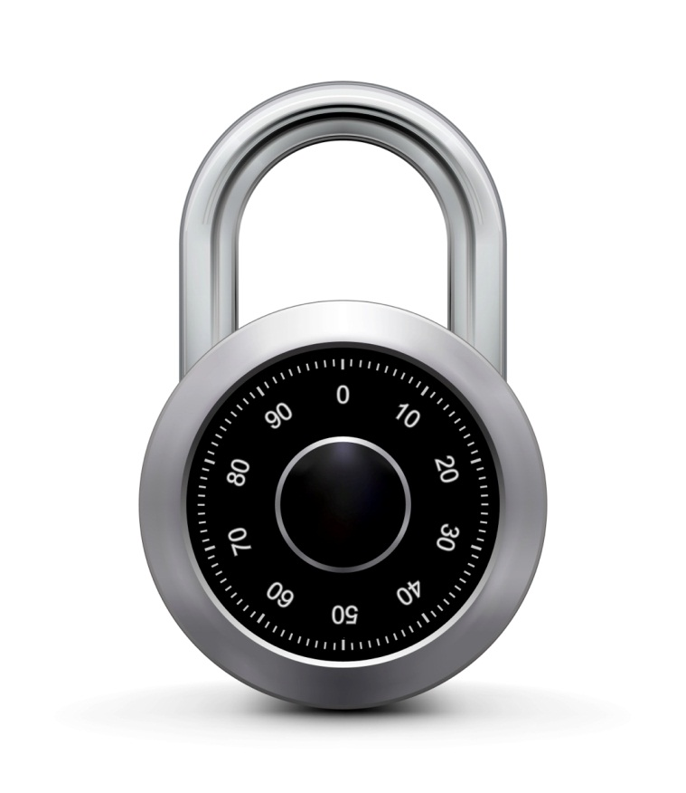
CBC-MAC and NMAC
Online Cryptography Course Dan Boneh
Message Integrity

Slide 2
MACs and PRFs
Recall: secure PRF F ⇒ secure MAC, as long as |Y| is large
S(k, m) = F(k, m)
Our goal:
given a PRF for short messages (AES)
construct a PRF for long messages
From here on let X = {0,1}^{n} (e.g. n=128)

Slide 3
Construction 1: encrypted CBC-MAC
raw CBC
m[0]
m[1]
m[3]
m[4]
⊕
⊕
⊕
F(k,⋅)
F(k,⋅)
F(k,⋅)
F(k,⋅)
Let F: K × X ⟶ X be a PRP
Define new PRF F_{ECBC} : K² × X^{≤L} ⟶ X
F(k₁,⋅)
tag
Notes:
Define the notation X^{<L}

Slide 4
Construction 2: NMAC (nested MAC)
cascade
m[0]
m[1]
m[3]
m[4]
k
t
F
F
F
F
>
>
>
>
t ll fpad
F
>
Let F: K × X ⟶ K be a PRF
Define new PRF F_{NMAC} : K² × X^{≤L} ⟶ K
k₁
tag
Notes:
Explain that both MACs use a final encryption step. The internal PRFs are only secure for prefix free messages --- simply say fixed length messages.
Cascade is a generalization of GGM. Is the basis of HMAC.

Slide 5
Why the last encryption step in ECBC-MAC and NMAC?
NMAC: suppose we define a MAC I = (S,V) where
S(k,m) = cascade(k, m)
This MAC is secure
This MAC can be forged without any chosen msg queries
This MAC can be forged with one chosen msg query
This MAC can be forged, but only with two msg queries

Slide 6
Why the last encryption step in ECBC-MAC?
Suppose we define a MAC I_{RAW} = (S,V) where
S(k,m) = rawCBC(k,m)
Then I_{RAW} is easily broken using a 1-chosen msg attack.
Adversary works as follows:
Choose an arbitrary one-block message m∈X
Request tag for m. Get t = F(k,m)
Output t as MAC forgery for the 2-block message (m, t⊕m)
Indeed: rawCBC(k, (m, t⊕m) ) = F(k, F(k,m)⊕(t⊕m) ) = F(k, t⊕(t⊕m) ) = t
Notes:
Note that forgery is an extension of query. rawCBC is a secure PRF if no message is a prefix of another (e.g. if all messages are same length).

Slide 7
ECBC-MAC and NMAC analysis
Theorem: For any L>0, For every eff. q-query PRF adv. A attacking F_{ECBC} or F_{NMAC} there exists an eff. adversary B s.t.:
Adv_{PRF}[A, F_{ECBC}] ≤ Adv_{PRP}[B, F] + 2 q² / |X|
Adv_{PRF}[A, F_{NMAC}] ≤ q⋅L⋅Adv_{PRF}[B, F] + q² / 2|K|
CBC-MAC is secure as long as q << |X|^{1/2}
NMAC is secure as long as q << |K|^{1/2} (2⁶⁴ for AES-128)

Slide 8
An example
Adv_{PRF}[A, F_{ECBC}] ≤ Adv_{PRP}[B, F] + 2 q² / |X|
q = # messages MAC-ed with k
Suppose we want Adv_{PRF}[A, F_{ECBC}] ≤ 1/2³² ⇐ q² /|X| < 1/ 2³²
AES: |X| = 2¹²⁸ ⇒ q < 2⁴⁸
So, after 2⁴⁸ messages must, must change key
3DES: |X| = 2⁶⁴ ⇒ q < 2¹⁶

Slide 9
The security bounds are tight: an attack
After signing |X|^{1/2} messages with ECBC-MAC or
|K|^{1/2} messages with NMAC
the MACs become insecure
Suppose the underlying PRF F is a PRP (e.g. AES)
Then both PRFs (ECBC and NMAC) have the following extension property:
∀x,y,w: F_{BIG}(k, x) = F_{BIG}(k, y) ⇒ F_{BIG}(k, xllw) = F_{BIG}(k, yllw)
Notes:
Actually, don’t need to assume F is a PRP.

Slide 10
The security bounds are tight: an attack
Let F_{BIG}: K × X ⟶ Y be a PRF that has the extension property
F_{BIG}(k, x) = F_{BIG}(k, y) ⇒ F_{BIG}(k, xllw) = F_{BIG}(k, yllw)
Generic attack on the derived MAC:
step 1: issue |Y|^{1/2} message queries for rand. messages in X.
obtain ( m_{i}, t_{i} ) for i = 1 ,…, |Y|^{1/2}
step 2: find a collision t_{u} = t_{v} for u≠v (one exists w.h.p by b-day paradox)
step 3: choose some w and query for t := F_{BIG}(k, m_{u}llw)
step 4: output forgery (m_{v}llw, t). Indeed t := F_{BIG}(k, m_{v}llw)

Slide 11
Better security: a rand. construction
2 blocks
m
k₁
k
rawCBC
t
>
>
rawCBC
r
tag
rand. r in X
Let F: K × X ⟶ X be a PRF. Result: MAC with tags in X².
Security: Adv_{MAC}[A, I_{RCBC}] ≤ Adv_{PRP}[B, F] ⋅ (1 + 2 q² / |X| )
⇒ For 3DES: can sign q=2³² msgs with one key
Notes:
Need to output r so tag can be verified.
Main point: attacker doesn’t know when collision happened on first rawCBC. So previous attack doesn’t apply.

Slide 12
Comparison
ECBC-MAC is commonly used as an AES-based MAC
CCM encryption mode (used in 802.11i)
NIST standard called CMAC
NMAC not usually used with AES or 3DES
Main reason: need to change AES key on every block
requires re-computing AES key expansion
But NMAC is the basis for a popular MAC called HMAC (next)

Slide 13
End of Segment

